Slide 1


NextGen Furnishings & Digital Store
Submitted By:
Patel Het Ashokkumar (221430131075)
Patel Bhagya Nitinkumar(221430131073)
Patel Neel Mukundlal(221430131081)
Sheth Anand Ajaykumar (221430131111)
Vedant Mukeshkumar Shah(221430131133)
Computer Science and Engineering(CSE) 5th Sem
New L J Institute of Engineering & Technology, Ahmedabad
Internal Guide:
Prof.Asiya Durani
Assistant Professor (CSE Department)
New L J Institute of Engineering & Technology, Ahmedabad

Slide 2
Outline
Introduction
Project Management
Prior Art Search (PAS)
System Requirements Study (Assessment-I)
System Analysis
System Design
Implementation
Testing (Assessment-II)
Limitation
Future Enhancement
Conclusion
References (Assessment-III)

Slide 3
Introduction
Project Summary & Profile:
The Furniture Innovation & Digital Store explores trends in furniture design and digital retail, using AR, VR, and AI for better customer experiences.
Case studies highlight successful digital strategies, while interactive features like price calculators and virtual showrooms enhance user engagement.
The project equips retailers with tools and insights to thrive in the digital marketplace.

Slide 4
Purpose:​
Revolutionize the furniture retail industry by integrating advanced digital technologies.
Enhance customer experience through personalized designs and innovative solutions.
Promote sustainability in material sourcing and manufacturing processes.
Expand market reach and improve efficiency through data-driven insights and digital marketing.

Slide 5
Scope & Objectives:
Scope:
Develop a user-friendly digital platform with a virtual showroom and customization tools.
Collaborate with designers and integrate IoT for innovative designs and supply chain optimization.
Focus on sustainability in material sourcing and manufacturing, while enabling customer co-creation.
Objectives:
The project enhances furniture retail by focusing on customer experience, innovation, and sustainability.
Data analytics guide product development and marketing strategies.
Digital marketing expands market reach and boosts brand visibility.
Continuous improvements ensure adaptation to evolving trends and technology.

Slide 6
Technologies:
Frontend: HTML, CSS, JavaScript, React.js
Backend: Node.js
Database: MongoDB

Slide 7
Project Management:
Project Planning:
Agile development model for iterative improvements.
Phased approach: requirements, design, development, testing, deployment.
Roles and Responsibilities :
Project Manager: Oversee project progress and coordinate team activities.
Software Engineers: Develop frontend and backend components.

Slide 8
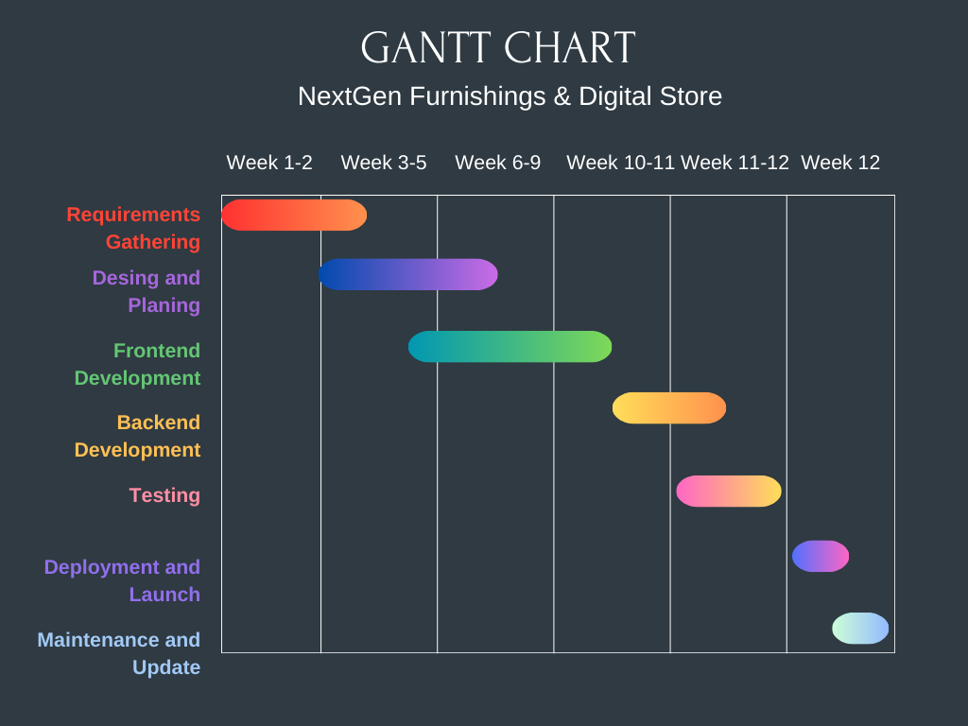
Project Scheduling -Gantt Chart

Slide 9
Risk Management:
Identification:
Inadequate infrastructure for handling high user traffic.
Technical challenges in integrating various technologies.
Analysis:
Disruption in Data Security, loss of data, reputational damage.

Slide 10
Prior Art Search (PAS):
Paper Title | Paper Author | Published year | Summary
The Usefulness of an Augmented Reality-Based Interactive 3D Furniture Catalog as a Tool to Aid Furniture Store Sales Operations | P. R. S. de Oliveira, R. T. A. Pereira, and C. B. D. Pimentel. | 2022 | The research paper evaluates the effectiveness of an augmented reality (AR) interactive 3D furniture catalog in enhancing sales operations for furniture stores. It demonstrates how AR technology improves customer engagement and decision-making by providing immersive and interactive product experiences. The study highlights increased sales efficiency and customer satisfaction through the implementation of AR-based tools
Applying Modern Interactive Techniques to Interior Designing of Home Furniture Stores | J. M. Smith, A. L. Brown, and K. P. Johnson. | 2024 | The paper explores the integration of modern interactive techniques into the interior design of home furniture stores. It examines how technologies like virtual reality and interactive displays enhance customer engagement and optimize store layouts. The research highlights the potential for these techniques to improve customer experience and boost sales.

Slide 11
System Requirements Study:
Existing System:
Problems: Data Management Issues, Scalability Constraint, Security Vulnerabilities.
Solutions: Enhance Data Management, Increase Scalability, Strengthen Security, Upgrade Technology.

Slide 12
Proposed System:
Modules & Features in the New System:
  Product Management: Create, organize, and manage product listings.
  Order Processing: Handle order placements, payments, and tracking
  Content Management: Manage product descriptions, images, and promotional content.
  Customer Support: Provide assistance through chat, email, and ticketing systems.

Slide 13
User Characteristics:
  Administrators: Manage system settings, oversee user accounts, and handle system configurations.
  Sellers/Vendors: List and manage products, process orders, and handle inventory.
  Customers: Browse products, place orders, view order history, and leave reviews.

Slide 14
Hardware & Software Requirements:
Hardware:
Processor: Intel Core i3 or equivalent
Memory: 4GB RAM
Storage: 128GB SSD or higher
Internet Connectivity
Software:
Operating System: Windows 10 or macOS Catalina
Web Browser: Google Chrome, Mozilla Firefox, Safari
Database: MongoDB
Development Framework: React.js

Slide 15
Assumptions
Customer Adoption: It is assumed that customers will be willing to engage with and adopt new
digital tools like AR and VR for furniture shopping.
Technology Integration: The necessary technologies (AR, VR, AI) will integrate smoothly into the
existing systems without significant delays.
Sustainability Demand: Customers will prioritize and value eco-friendly and sustainable furniture
options, driving demand.
Partnership Support: Strategic partners (designers, tech providers, manufacturers) will actively
collaborate and support project goals throughout the development.

Slide 16
Dependencies
Technology Providers: The project depends on timely delivery and integration of AR, VR, and AI technologies from external vendors.
Supply Chain Partners: Dependence on sustainable material suppliers and manufacturers for eco-friendly furniture production.
Customer Engagement: The success of interactive tools like virtual showrooms relies on customer willingness to use and engage with these features.
Marketing and Sales Teams: The effectiveness of digital marketing strategies and staff training is critical for expanding market reach and ensuring smooth operations.

Slide 17
System Analysis:
Technical Feasibility:
  Evaluate system requirements (hardware and software)
  Address scalability (vertical and horizontal)
  Integrate with payment gateways, shipping providers, and CRM systems
  Implement security measures and performance optimization
Operational Feasibility:
  Assess user acceptance and experience
  Manage content effectively (product info, promotions)
  Ensure maintenance and support for functionality and security
Economic Feasibility:
  Perform cost-benefit analysis (costs vs. benefits)
  Conduct risk analysis (financial risks and impacts)

Slide 18
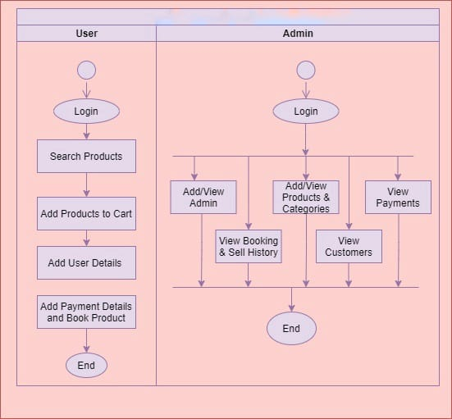
System Activity Diagram:
NextGen Furnishings & Digital Store

Slide 19
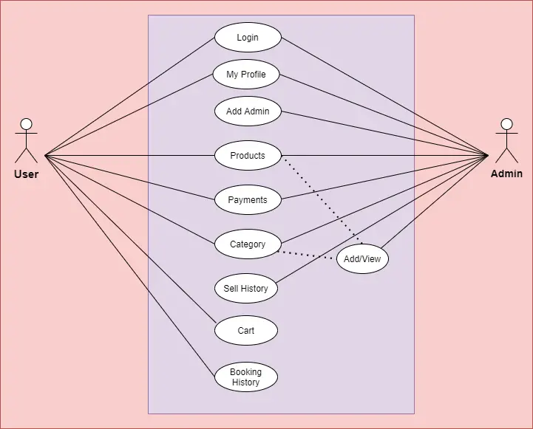
Use Case Diagram:
NextGen Furnishing & Digital Store

Slide 20
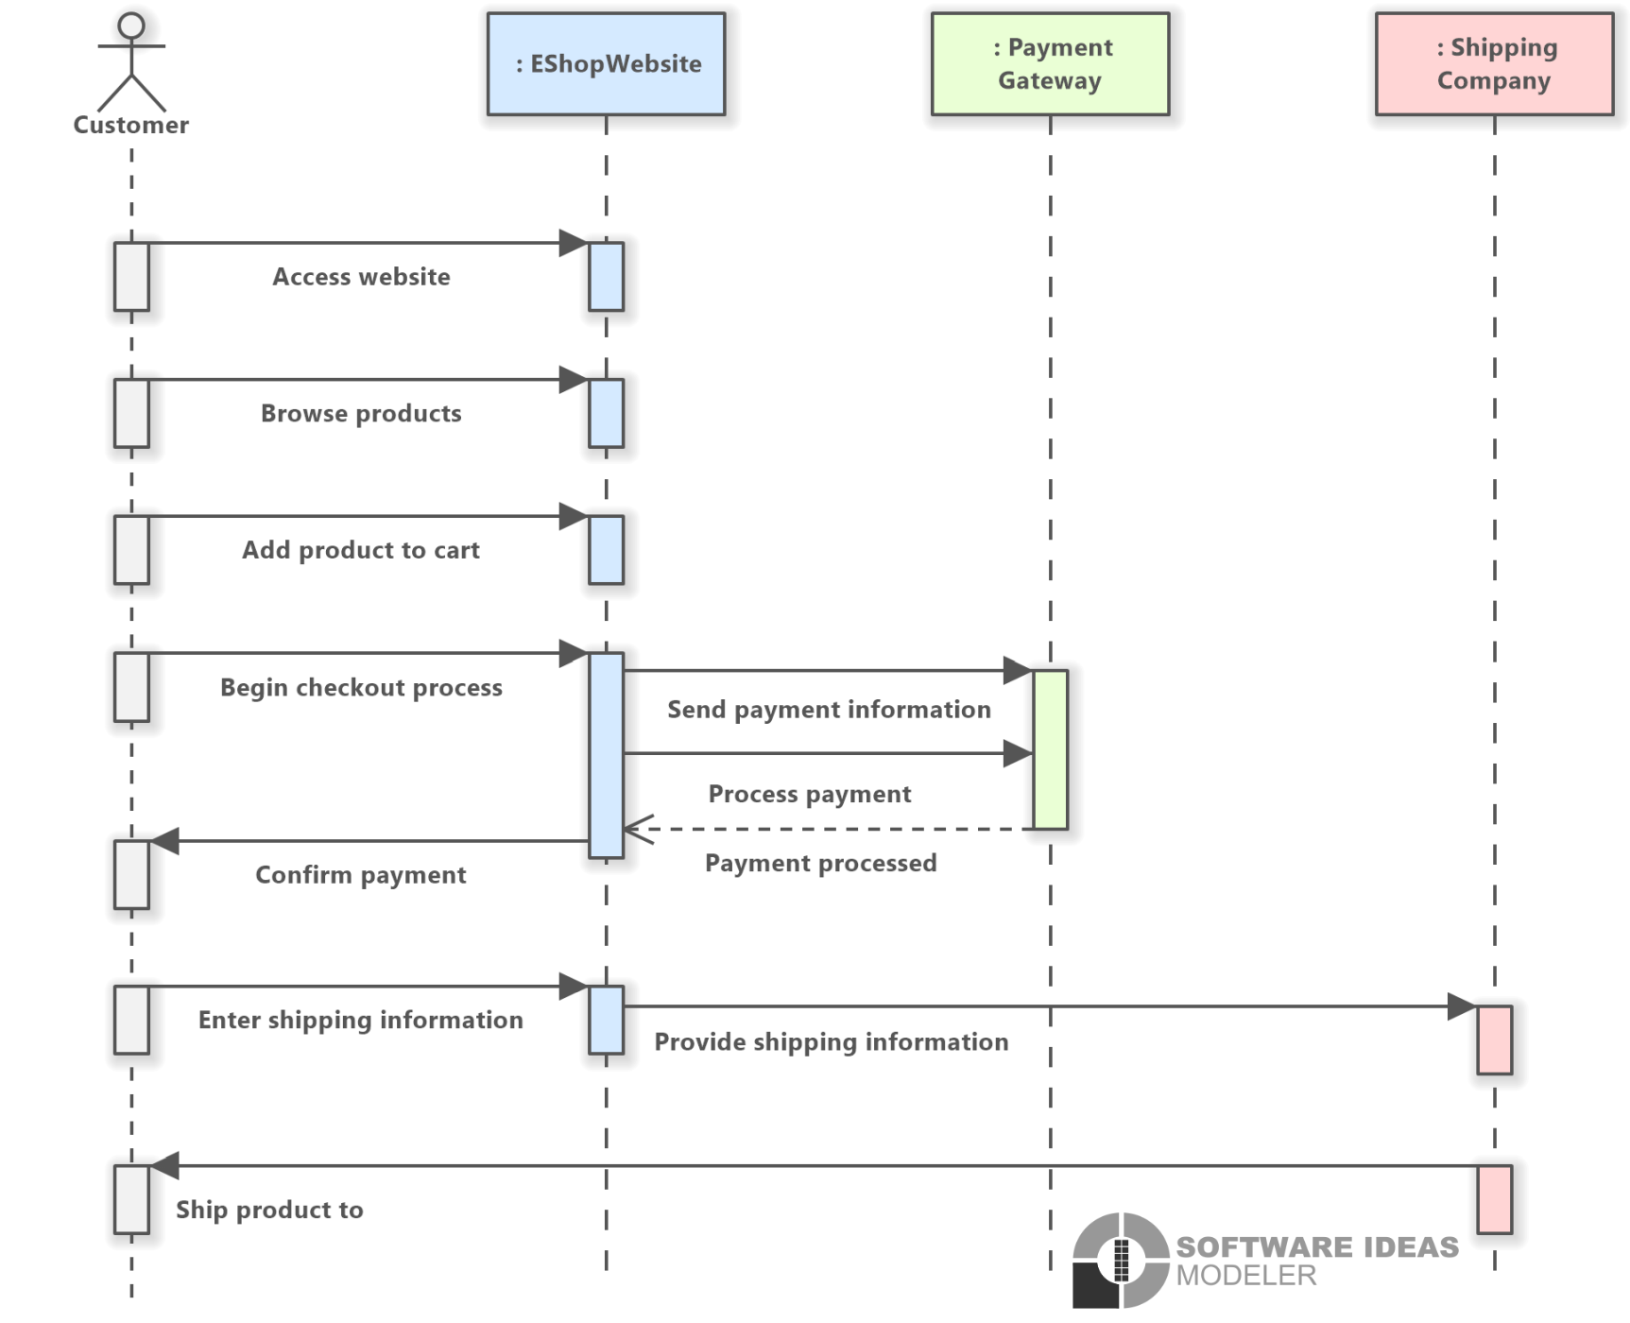
Sequence
Diagram:

Slide 21
System Design:
Database Design/Data Structure Design:
User | Product
User_id (Primary Key) | Product_id (Primary Key) | Instructure_id (Primary Key)
User_name | Product_name | Instructure_name
Customers and Products Relationship:
Many-to-Many Relationship: A customer can purchase multiple products, and a product can be bought by multiple customers.

Slide 22
Products and Categories Relationship:
Many-to-One Relationship: A product belongs to a single category, but a category can include multiple products.
Customers and Orders Relationship:
One-to-Many Relationship: A customer can place multiple orders, but each order is typically associated with a single customer.
Orders and Products Relationship:
Many-to-Many Relationship: An order can include multiple products, and a product can appear in multiple orders.
Customers and Reviews Relationship:
One-to-Many Relationship: A customer can leave multiple reviews, but each review is typically written by a single customer.

Slide 23
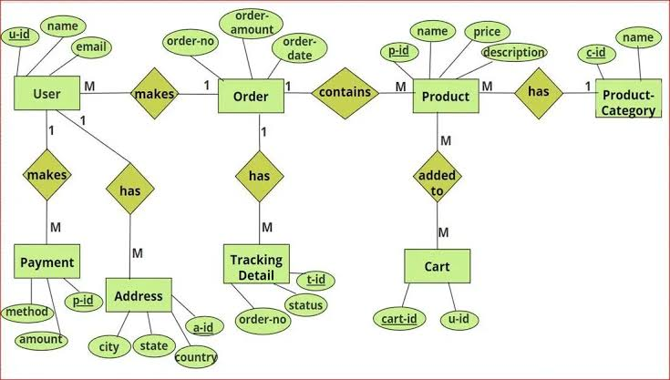
ER Diagram:

Slide 24
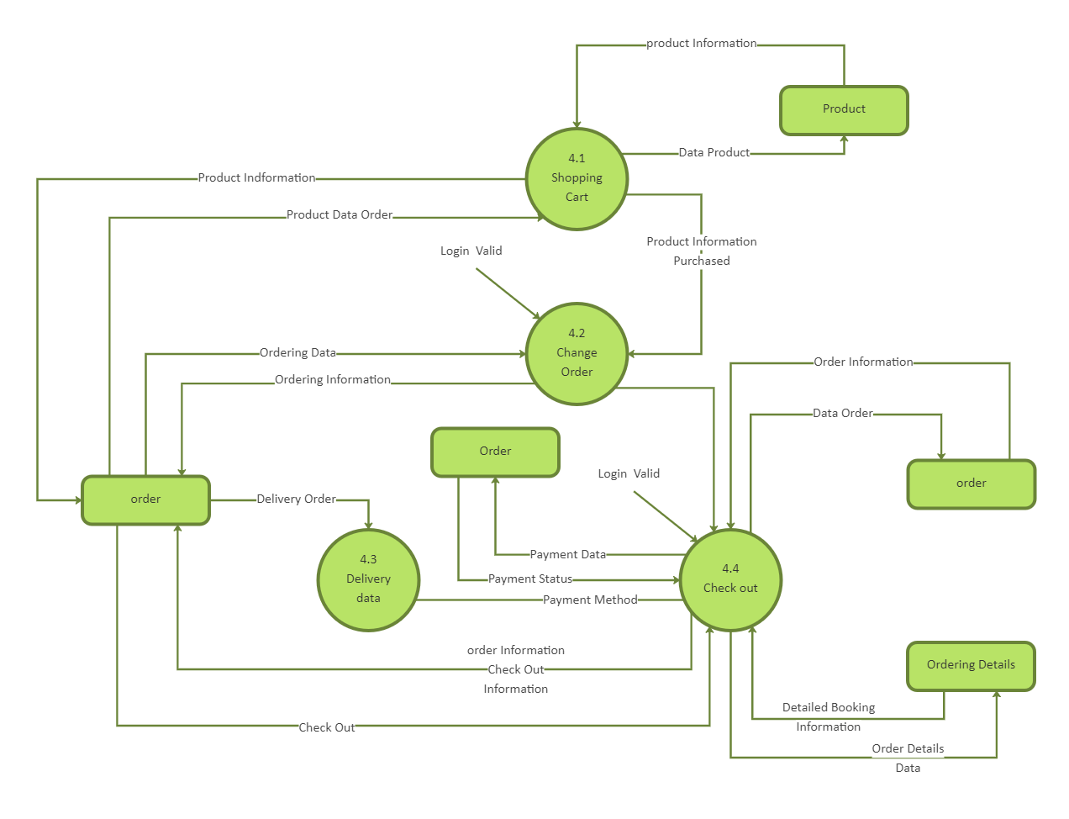
Data FlowDiagram:

Slide 25
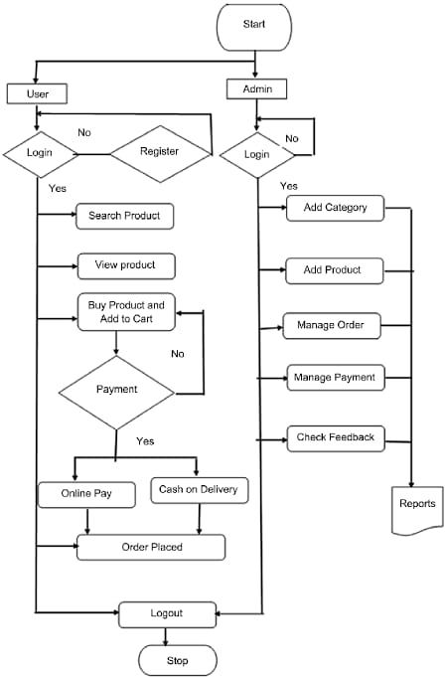
Flow Chart:

Slide 26
Implementation:
Single-user:
  Designed for individual use
  Focuses on personal shopping experiences
  Minimal interaction with other users
Multi-user:
  Supports interactions among customers
  administrators, and support staff
  Enables features like customer reviews, admin dashboards, and user support

Slide 27
GUI (Graphical User Interface):
  Provides a visual and interactive interface
  Enhances user experience with graphical elements
  Makes navigation intuitive and engaging
Non-GUI:
  Uses text-based interfaces for user interactions
  Suitable for backend operations or specific environments
  Less visually engaging but functional for certain use cases

Slide 28
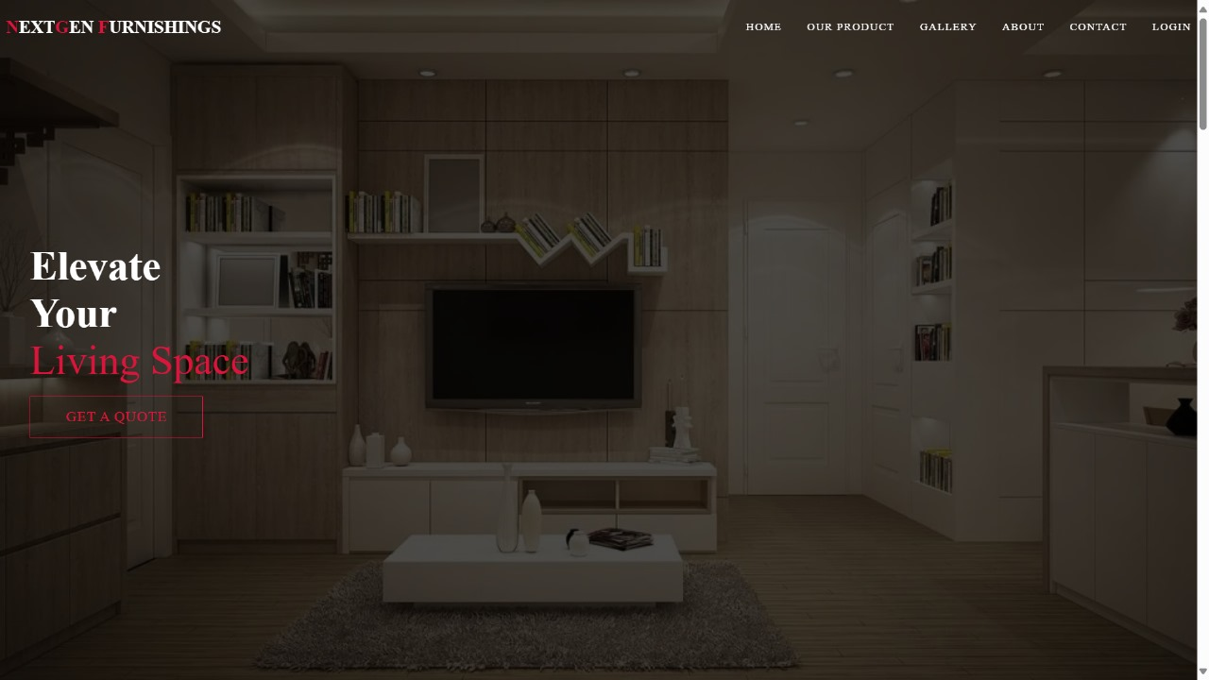
Screenshots Of Forms, Reports and Interface:

Slide 29
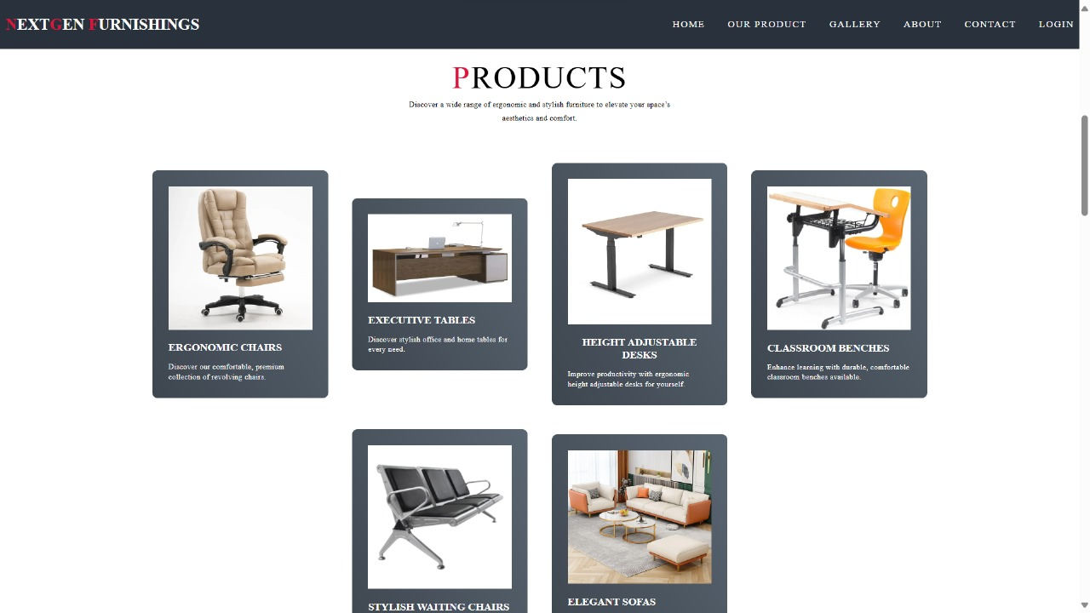

Slide 30
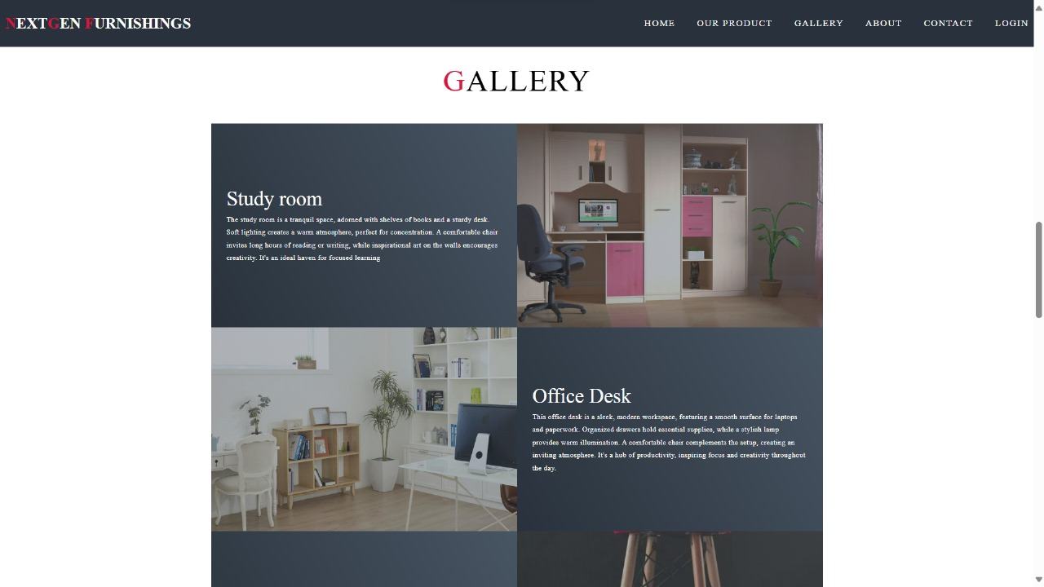

Slide 31
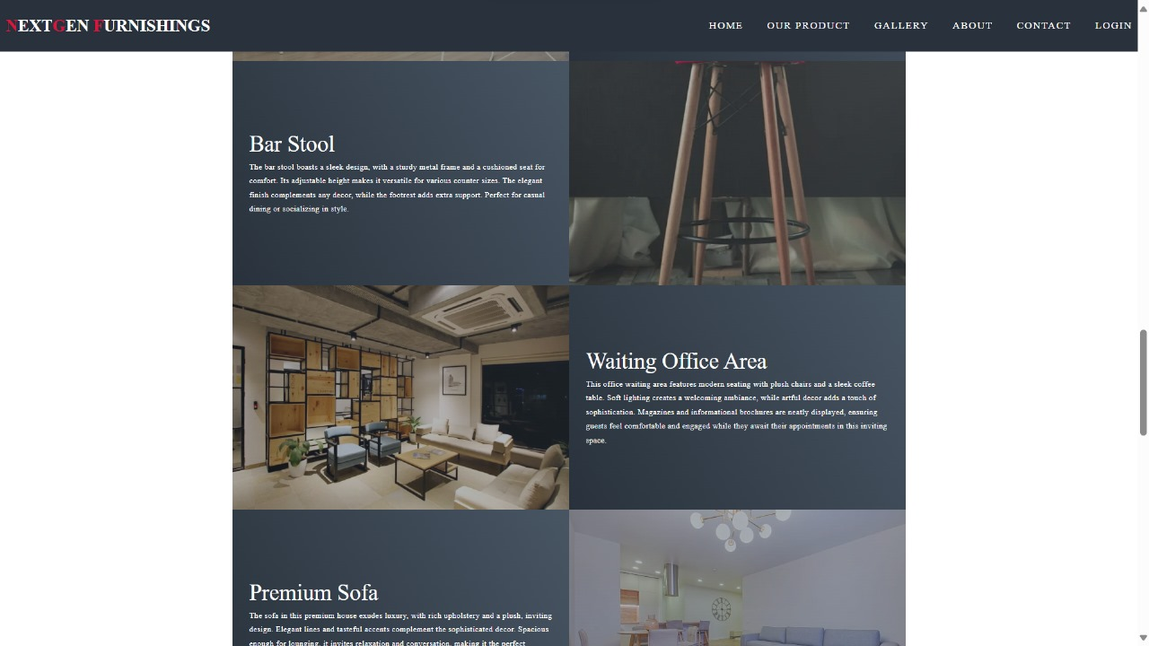

Slide 32
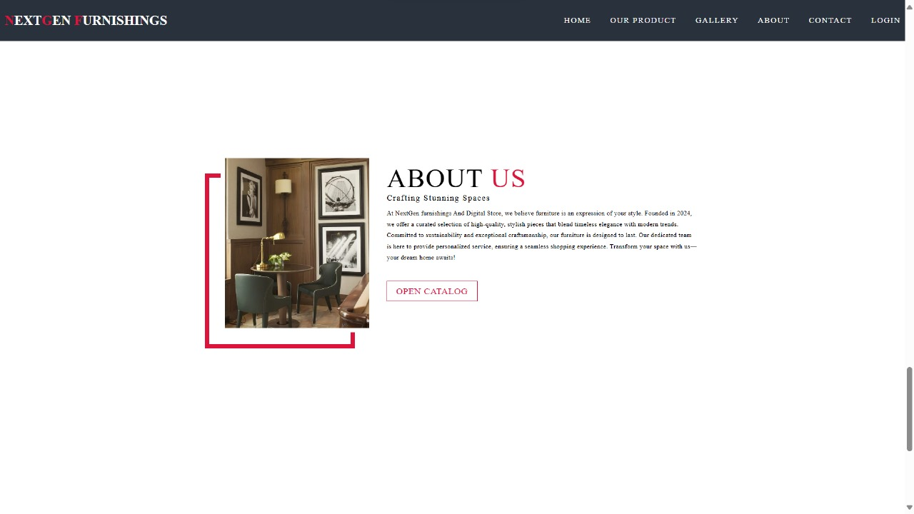

Slide 33
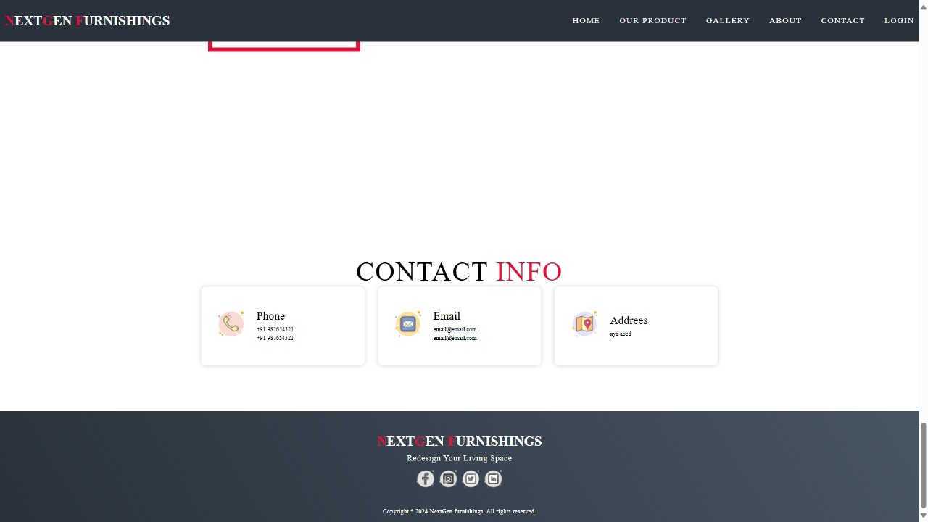

Slide 34
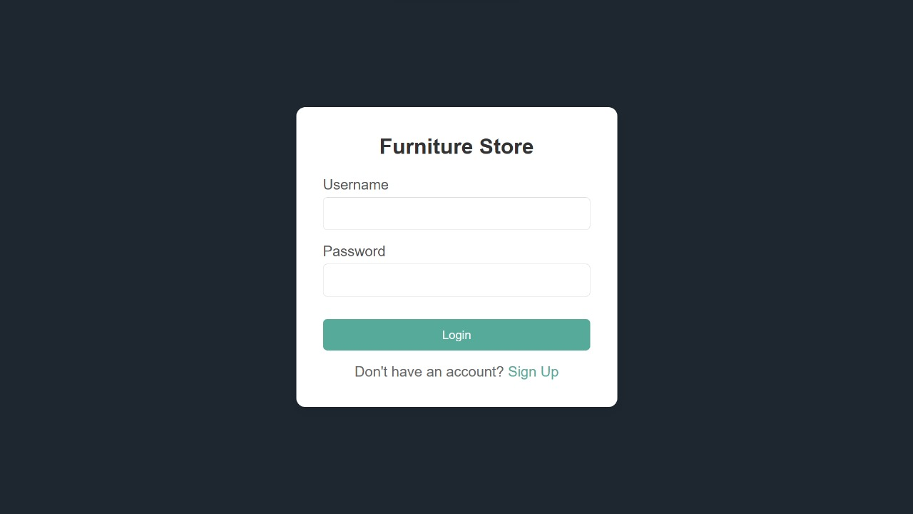
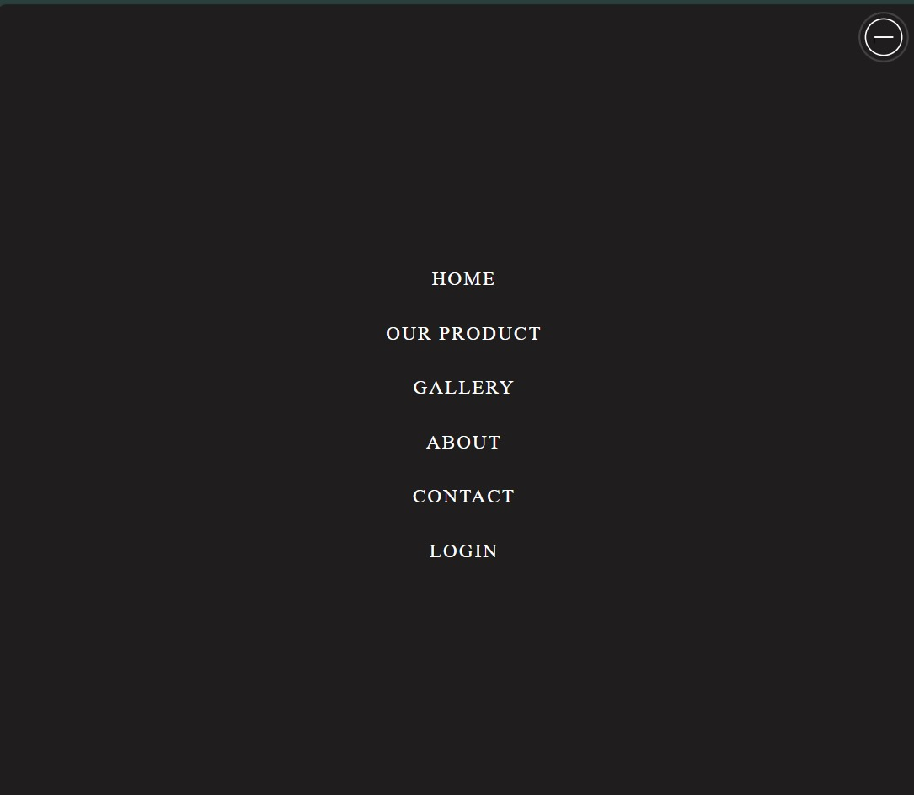

Slide 35
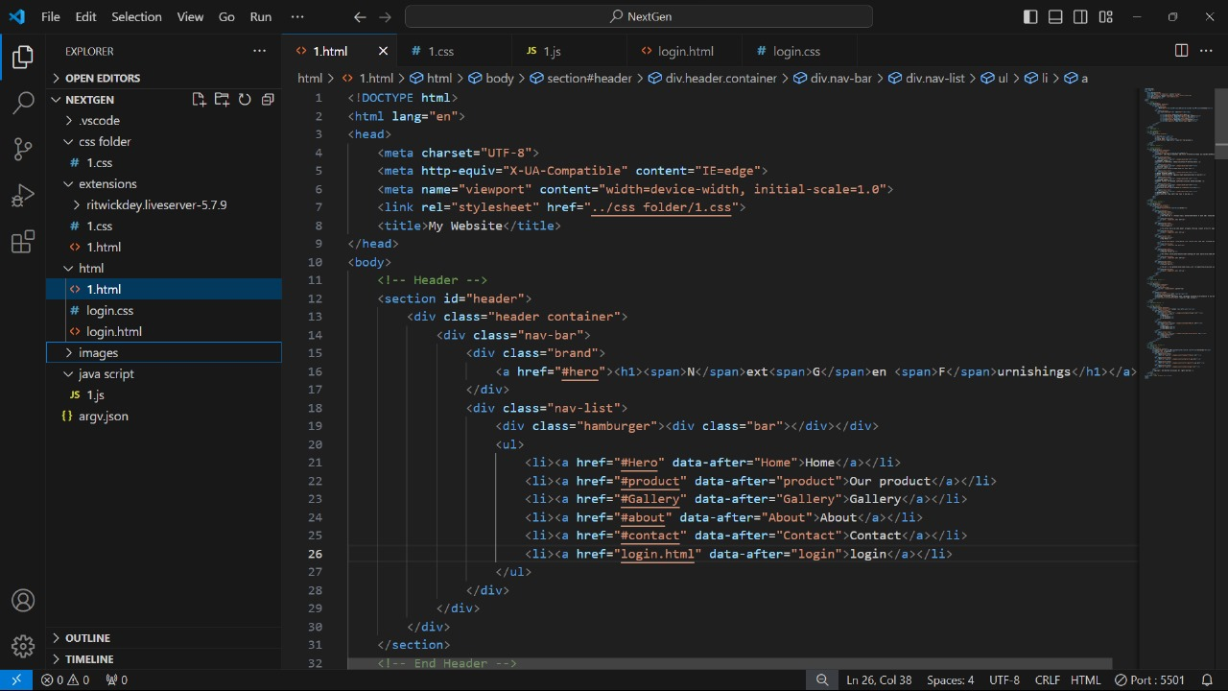

Slide 36
Testing:
Testing Plan & Strategy:
Objectives: Ensure Smooth Functionality, Usability, Security, Performance
Testing Types: Functional, Usability, Performance, Security, Compatibility
Test Cases: Product Search and Filtering, Adding Items to the Cart, Checkout Process, Order Confirmation and Tracking, User Account Management
Execution: Test in Different Environments, Allocate Resources, Schedule Phases

Slide 37
Process: Functional, Usability, Performance, Security, Compatibility Testing
Iterative Testing: Continuous testing after updates to refine and enhance the e-commerce website.
Automation: Automate repetitive tests to improve efficiency and accuracy.
Conclusion: Thorough testing guarantees a reliable, secure, and user-friendly e-commerce website.

Slide 38
Testing Methods:
Functional Testing: Ensure all e-commerce features work as intended.
Usability Testing: Evaluate user interface and shopping experience.
Performance Testing: Assess system responsiveness and scalability.
Security Testing: Identify and address vulnerabilities.
Compatibility Testing: Verify across browsers and devices.
Accessibility Testing: Ensure compliance with accessibility standards.
Load Testing: Measure performance under heavy traffic.

Slide 39
Test Cases (Table with following columns)
Purpose | Required Input | Expected Result
User Login | Username, Password | Successful login
 | Incorrect Username/Password | Error message displayed
Course Enrollment | Course selection | Enrollment confirmation
 | Already enrolled in course | Error message displayed

Slide 40
Limitation:
Lack of Customization:While users can location and examine furniture fashions of their real surroundings, there seems to be no point out of customization alternatives (like shade, size, and so on.) restricting the personalization of the purchasing experience.
Increased Costs and Channel Conflict: Implementing eCommerce through website can be costly. Retailers will have to struggle with this because of the conflict between online sales and brick-and-mortar operations, especially in dealing with shipping and delivery costs.
Limited Online Sales: While 3D models can simulate a realistic shopping experience, it hasn't significantly boosted online furniture sales. Consumers are hesitant to buy furniture online due to delivery inconveniences and a lack of confidence in purchasing large, costly items without physical interaction.
Limited User Interaction: Customers might not get direct control over the virtual environment; they relied on the sales assistant for adjustments. This limited their engagement and interaction.
Data Storage:The application relies on for storing user and product data. 3D models requires more robust backend solutions for scalability. It requires a large amount of storage to be loaded

Slide 41
Future Enhancement:
Improving Customer Comfort: Adjustments could be made to increase customer comfort during the VR session, such as offering shorter immersive experiences or ensuring a more private and safe environment.
Incorporating More Sensory Feedback: Expanding the multisensory feedback system (e.g., adding more tactile elements or scents) could make the experience even more immersive.
Expanding Product Offerings: The VR journey could be expanded to include more diverse product ranges, allowing users to configure a broader selection of items that may not be available in-store.Enhanced Model.
Quality and Realism: Support for more complex, higher-resolution models can be introduced to improve realism, especially with better reflection, texture, and lighting control. This would require enhanced hardware support for real-time rendering of detailed 3D models.
Offline Functionality: Allowing some offline functionality or downloading selected 3D models for offline use could improve usability in areas with limited connectivity

Slide 42
Conclusion:
In conclusion, implementing 3D visualization and a budget mechanism offers furniture retailers an innovative way to enhance customer experience by enabling realistic product exploration and cost management. Despite high initial costs and the lack of tactile feedback, this approach reduces inventory needs, optimizes store space, and improves customer decision-making, making it a valuable asset for the future of furniture retail.

Slide 43
References:
Reference 1: The usefulness of an Augmented Reality-based Interactive 3D Furniture Catalog as a Tool to Aid Furniture Store Sales Operations
Reference 2: Applying Modern Interactive Techniques to Interior

